Slide 1


Robotic Positioner
PRESENTED BY GROUP 5: Thomas Hu, Jordan Smith, Jason Wong

Slide 2
Agenda
Doepker Industries Ltd
Problem Description
Requirements Analysis
System Alternatives
System Design

Slide 3
DOEPKER INDUSTRIES LTD

Slide 4
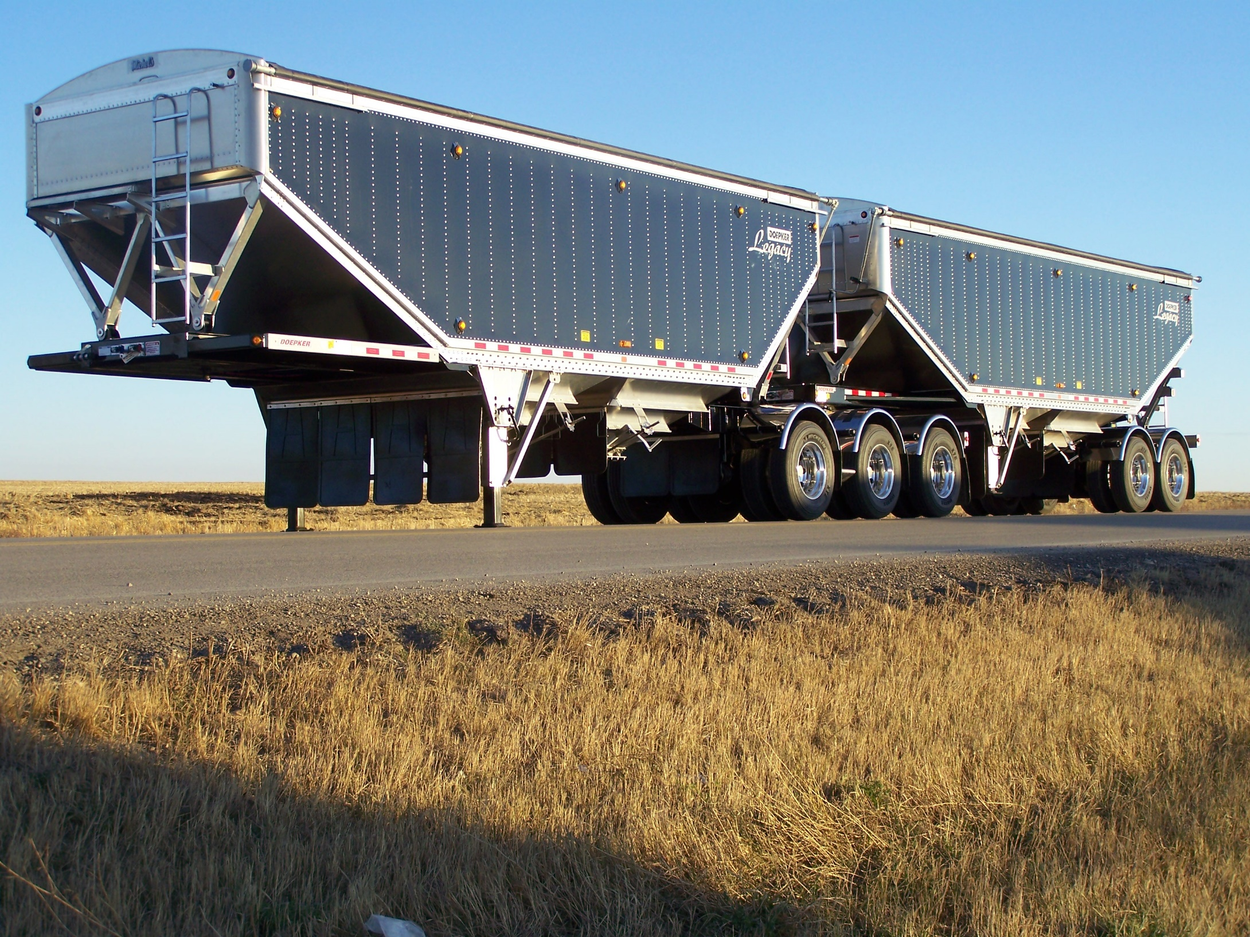
About Doepker Industries
Provides value in the transportation industry in North America
Agriculture
Flat decks
Oil & gas
Forestry
Gravel
Heavy haul

Slide 5
PROBLEM DESCRIPTION

Slide 6
Problem Definition
A device which can be used to rotate equipment for welding, blasting, painting, or finishing that can be mounted to their existing rotator frames.

Slide 7
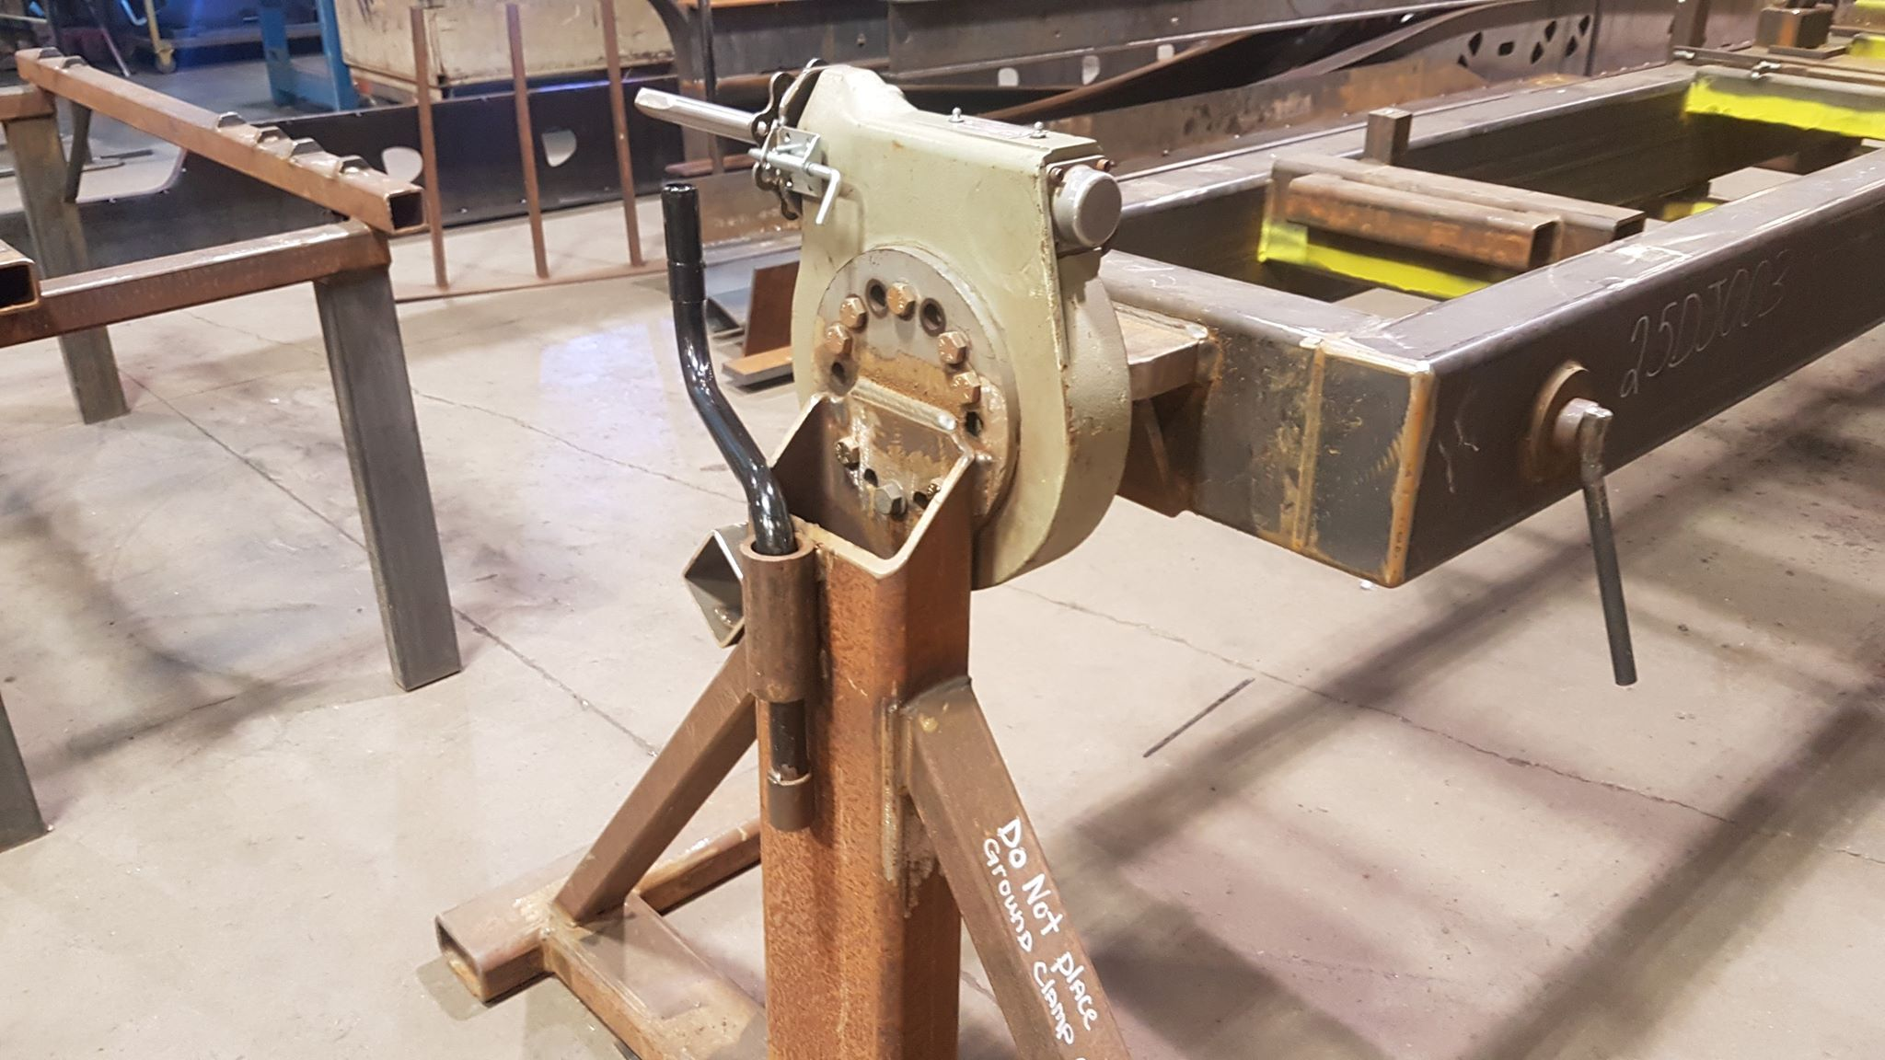
Why is this important?
Currently uses mechanical equipment
Advancing mechanical machines forward with electronics.
Provides a safer environment for the users.
Improves efficiency.

Slide 8
Problem Statement
“There exists a need for a low-cost system that can electrically rotate a load for welding applications to increase efficiency and safety.”

Slide 9
REQUIREMENTS ANALYSIS

Slide 10
Design Requirements
The System Shall:
rotate a load 360˚ around the horizontal axis
recall and rotate to a preset angular position
support up to max load of 500 kilograms
have a rotation speed between 1-5 rpm
be built using two “A” frame supports
not exceed $10,000 Canadian Dollars to build
use RoHS compliant components

Slide 11
SYSTEM ALTERNATIVES

Slide 12
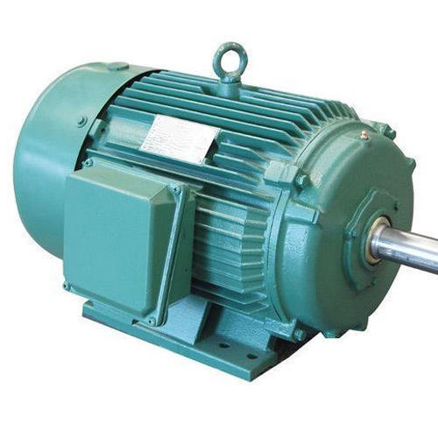
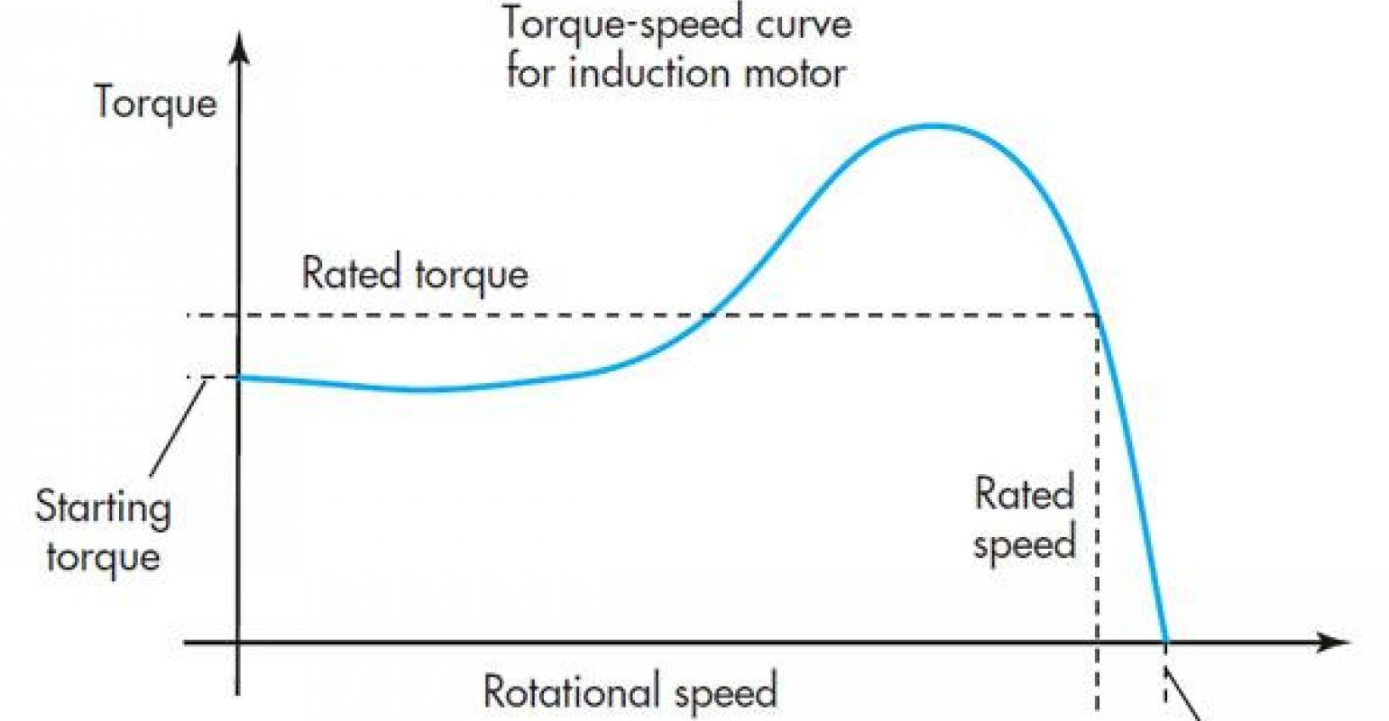
Motor Alternatives
Induction Motors
Pros
Inexpensive
Easy to maintain
Cons
Speed control is very limited and expensive via variable frequency drive
High in rush current when heavy loaded
Requires external positioning sensors

Slide 13
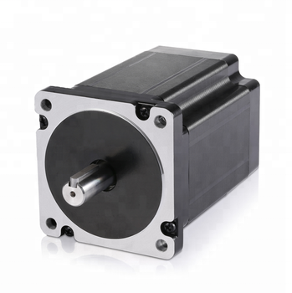
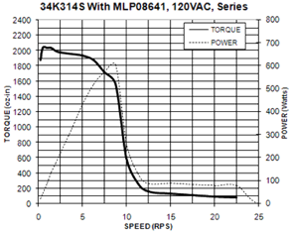
Motor Alternatives
Stepper Motors
Pros
High torque at lower speeds
Relatively simple operation
Possible to operate in closed loop feedback eliminating external sensor
Cons
Sudden drop off in torque as speeds increase
Noisy
Requires external driver

Slide 14
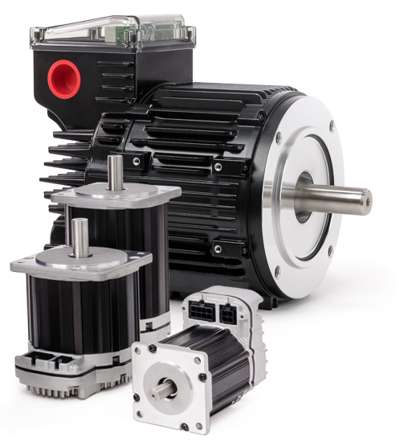
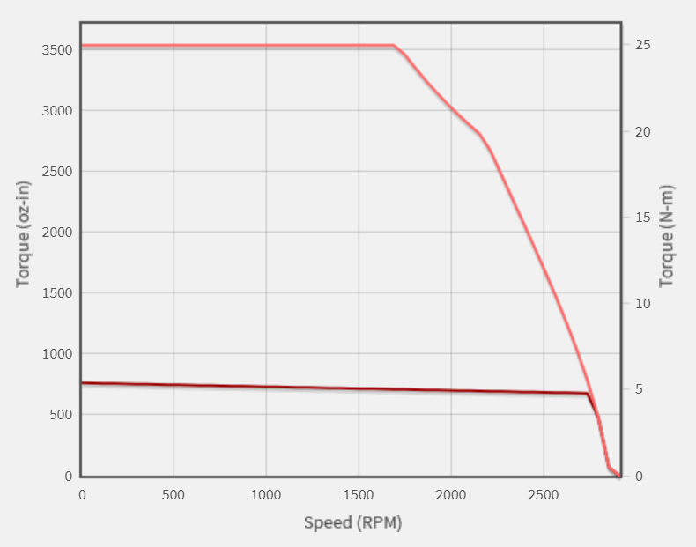
Motor Alternatives
Servo Motors
Pros
Encoder allows for a closed loop feedback operation
Near constant torque within operational speeds
Integrated encoder for high precision position tracking
Cons
Expensive

Slide 15
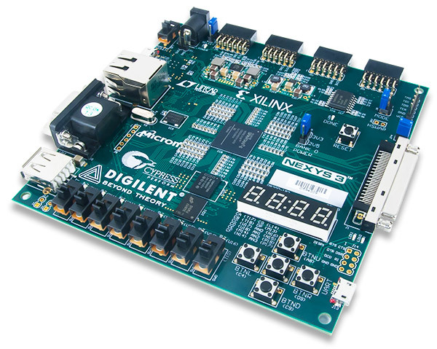
Control System Alternatives
FPGA
Pros
Precise PWM motor control
Optimal performance
Cons
Time intensive software development
Difficult memory management
Can be expensive
Notes:
Pros: powerful, better optimization of the program

Slide 16
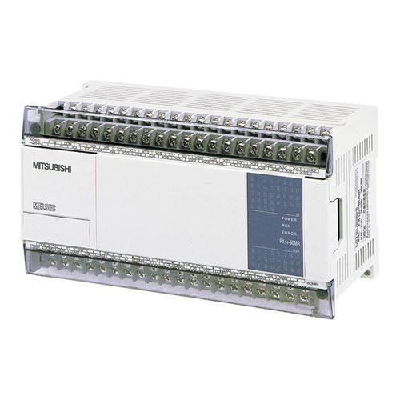
Control System Alternatives
Programmable Logic Controller (PLC)
Pros
Reliability
Remote control
Possible to operate in closed loop feedback eliminating external sensor
Cons
Expensive
Not much benefit for this application

Slide 17
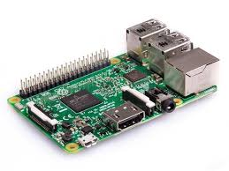
Control System Alternatives
Microcomputer
Pros
Simple learning curve
Powerful in terms of processing power
Cons
Analog to digital conversion
Less accurate timing control
SD card will wear out
Notes:
Cons: less flexible when it comes to real-time and analog usage (ex. Sensors and chips)
- Reading analog sensors require extra hardware assistance

Slide 18
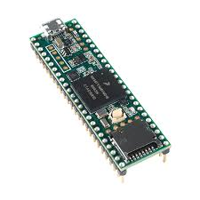
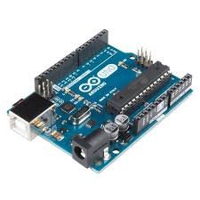
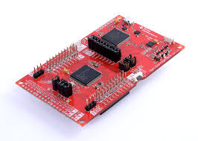
Control System Alternatives
Microcontroller
Pros
Quickly prototype projects
Robust memory management
Abundant or expandable pins & ports
Reasonable learning curve
Inexpensive
Cons
Reliability

Slide 19
Choosing A System
Employed a weighted decision matrix based on requirements and safety considerations:
Requirement | Weight | FPGA | PLC | Microcomputer | Microcontroller
Cost | 20% | 2 | 1 | 3 | 4
Memory Management | 20% | 1 | 2 | 3 | 4
Compatibility | 20% | 4 | 2 | 1 | 3
Reliability | 20% | 4 | 3 | 1 | 2
Development | 20% | 1 | 3 | 2 | 4
TOTAL | 100% | 2.4 | 2.2 | 2 | 3.4

Slide 20
SYSTEM DESIGN

Slide 21
MICROCONTROLLER
SERVO MOTOR
A compact integrated circuit designed to operate the motor.
A rotary actuator or linear actuator that allows for precise control of angular or linear position, velocity and acceleration.
ENCODER
GEARBOX
A motor mounted encoder provides closed loop feedback signals to communicate the speed and position of the motor shaft.
A mechanical drive to step down the speed of rotation from the motor shaft to the output drive, proportionally increasing the torque.
Key Components

Slide 22
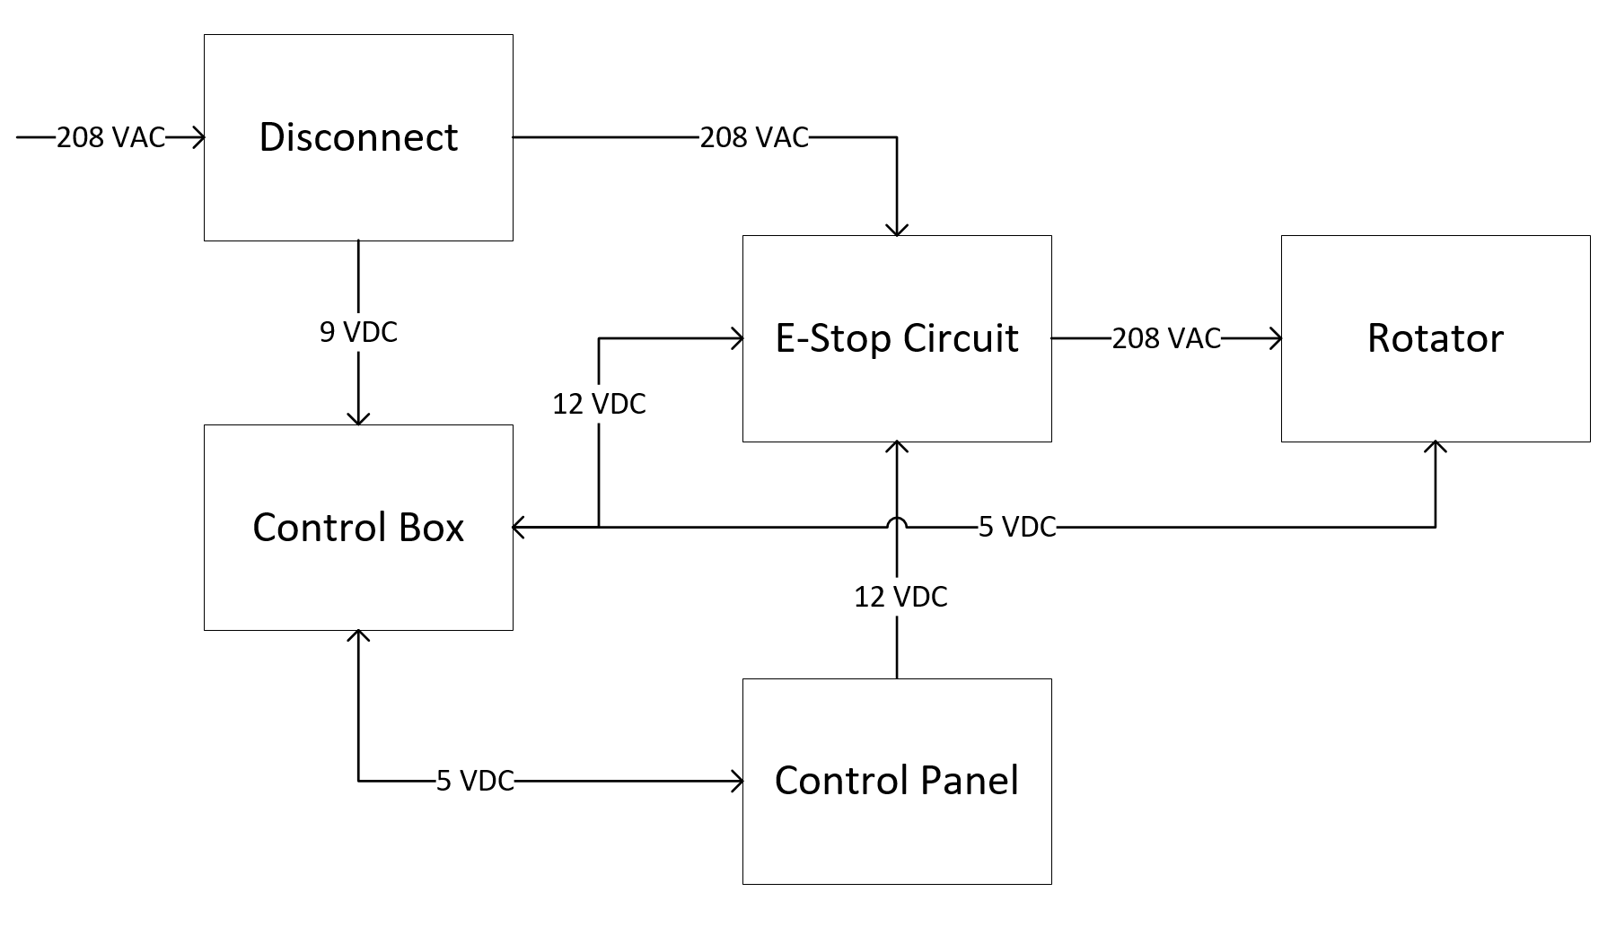
System-Level Block Design
Hardware Design

Slide 23
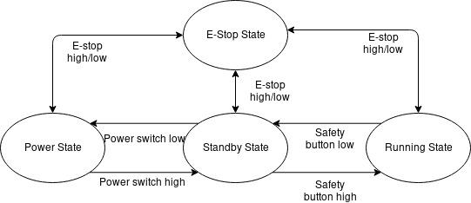
System-Level Block Design
Software Design

Slide 24
Q&A

